Slide 1
Speech Production

Slide 2
Objectives:
Identify the human speech organs;
Explain the function of each organ in speech production;

Slide 3
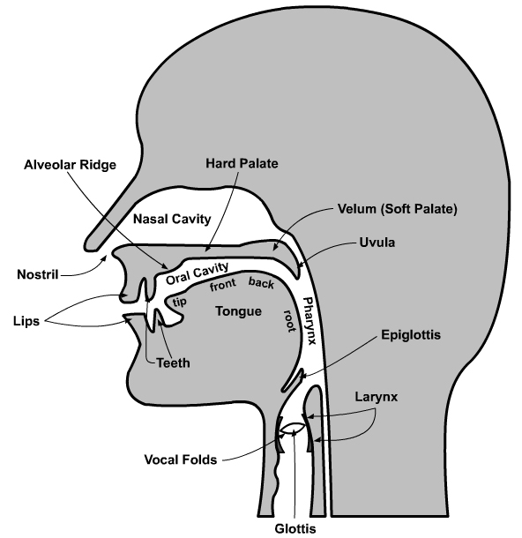
a) Human Speech Organs

Slide 4
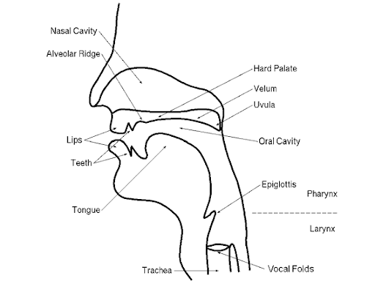

Slide 5
b) Functions of Human Speech Organs
i) The lungs:
Involved in speech production during the normal course of breathing
Ingoing air flow is known as ingressive pulmonic air stream while the outgoing
flow is egressive pulmonic air stream.
Egressive airstream is utilized for speech production more than ingressive.
It is expelled from the lungs, passes through the wind pipe or trachea, and in the process it is manipulated at different points for speech production.

Slide 6
ii) The Larynx: (voice box)
a bonny structure situated at the top of the trachea (wind pipe).
The part that extends outwards is normally called The Adam’s apple.
The larynx acts as a valve which closes to protect the lungs and opens for air to get in.
It houses the vocal cords

Slide 7
iii)The Larynx contd …
Vocal cords are two flexible folds/flaps in the larynx. The space between vocal cords is known as the glottis
- Open Glottis; the vocal cords are drawn apart and air passes through them freely to produce voiceless sounds e. g. /t/,
/ʃ/, /f/
-Narrow/closed Glottis; the vocal cords are drawn together causing obstruction of airflow. The result is a vibration hence voiced sounds e. g. /b/, /d/, /g/

Slide 8
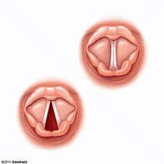
VOCAL CORDS
CLOSED GLOTTIS
OPEN GLOTTIS

Slide 9
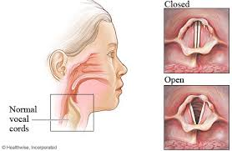

Slide 10
iv) Pharynx:
This is a cavity at the entrance to the windpipe.
It serves as a tube connecting the larynx with the oral cavity and the nasal cavity.
After reaching the pharynx, the air can be directed either through the mouth or nose.

Slide 11
v) Soft palate (Velum)
this is the soft tissue at the back of the roof of the mouth. It appears like a curtain hanging down the roof the mouth.
The soft palate is flexible; may be raised or lowered to determine direction of airflow.
When it is raised, it blocks the nasal cavity obstructing outgoing airflow.
The air passes out through the mouth, thus producing ORAL SOUNDS. E.g. /p/ /b/, /t/ /d/, /k/ /g/, /f/ /v/, /s/ /z/,
When the velum is lowered it blocks the oral cavity allowing airflow through the nose / nasal cavity, thus producing NASAL SOUNDS. /m/, /n/, /ŋ/

Slide 12
iv) Hard palate :
It is part of the roof of the mouth btw the alveolar and the velum.
the hard palate works in conjunction
with the tongue to produce Palatal sounds
The tongue is raised and moves close to or be in contact with the hard palate.
This contact or near contact obstructs airflow either partially or fully to produce varying voiced or voiceless consonants/,
Examples: /ʃ/ /ʒ/, /ʈʃ/

Slide 13
iiv) Alveolar ridge
found on the roof of the mouth between the upper teeth and the hard palate.
It works with the tip of tongue to obstruct outgoing airstream for production of several voiced and voiceless consonants.
Examples /s/ /z/,/t/ /d/,

Slide 14
iiiv) The teeth
Both the upper and the lower teeth ridge are involved in articulation of sounds.
The upper teeth come into contact with with the lower lip to produce labial-dental sounds. /f/ /v/
the blade of the tongue obstructs airflow between upper and lower teeth to produce dental sounds.
/θ/ /ð/,

Slide 15
lips
The upper and lower lips are drawn together to obstruct airflow for production of bilabial sounds /p/ /b/,
In production of vowels, the lips function in four different positions:
They are -spread as in the vowel /i:/ seen
- neutral as in the vowel/ə/about
- close/rounded as in the vowel /ʊ:/moon
- open/ rounded as in the vowel /ɔ/pot

Slide 16
The tongue
The most active articulator.
Consists of five parts; the tip, the blade, the front, the back and the root.
It gets in contact with upper teeth, alveolar, hard palate, and soft palate to produce consonants.
It also makes different movements in articulation of vowels

Slide 17
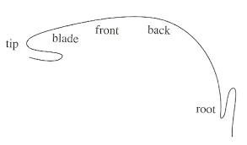
ix) tongue
Parts of the tongue
Pharyngeal Wall

Slide 18
The End

