Slide 1
SPEECH PRODUCTION

Slide 2
The Sounds of English
Consonants

Slide 3
Objectives
Identify English consonants.
Differentiate between consonant letters and sounds.
Explain the articulation of consonants.
Classify and describe consonants correctly.

Slide 4
English consonants
A consonant is a sound produced with complete or partial obstruction of airflow at the point of articulation.
There are 24 consonants in English.
English consonants:
/p/ /b/, /t/ /d/, /k/ /g/, /f/ /v/, /s/ /z/,
/θ/ /ð/, /ʃ/ /ʒ/, /ʈʃ/, /dʒ/, /n/, /m/, /r/, /j/, /ŋ/, /l/, /h/, /w/

Slide 5
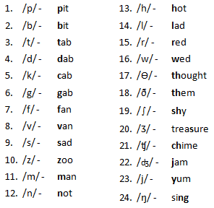

Slide 6
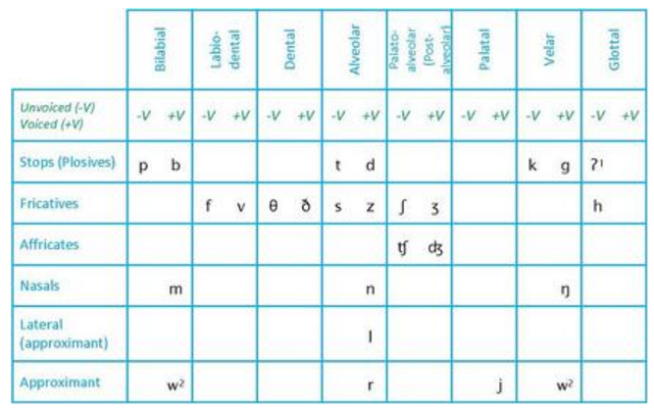
Consonant Chart
Consonant Chart

Slide 7
Consonant classification chart
 | bilabial | Labio-dental | Dental | Alveolar | Palato- alveolar | Palatal | velar | Glottal
voicing Stop/ plosive | -v +v p b | -v +v | -v +v | -v +v t d | -v +v | -v +v | -v +v k g | -v +v
fricative |  | f v | θ ð | s z | ʃ ʒ |  |  | h
Affricates |  |  |  |  | ʈʃ dʒ
Nasals | m |  |  | n |  |  | ŋ
Laterals |  |  |  | l
Approximants | w |  |  | r |  | j

Slide 8
Point/ place of articulation
Bi-labial – articulation occurs at the lips where obstruction of airflow takes place /p/, /b/, /m/
Labio-dental –obstruction of airflow between the lower lip and upper teeth ridge /f/, /v/
Dental- obstruction between the upper and lower teeth aided by the tongue /θ/ /ð/
Alveolar – Obstruction between tip and front of tongue versus alveolar ridge. /t/ /d/, /s/ /z/,

Slide 9
Place of articulation
Palato – alveolar – obstruction of airflow between the centre of the tongue and the hard palate /ʃ/ /ʒ/, /ʈʃ
Palatal – obstruction of airflow occurs between the centre of the tongue and the hard palate / j/
Velar – obstruction of airflow is between the back of the tongue and the velum /k/, /g/, /ŋ/
Glottal – obstruction occurs at the epiglottis /h/

Slide 10
Manner of articulation
The action at the point of articulation. How is the sound produced?
Stops ( plosives) – complete blockage at the point of articulation followed by sudden release of the same air. /p/ /b/, /t/ /d/, /k/ /g/,
Fricatives –Partial obstruction of airflow. This results to friction as airflow is forced out through a narrow passage /f/ /v/, /s/ /z/, /θ,/ /ð/, /ʃ/ /ʒ/, /ʈʃ/

Slide 11
Manner of articulation
Affricates – complete blockage followed by partial blockage resulting to combined plosive/fricative sound /ʈʃ/, /dʒ/
Nasals – complete obstruction at place of articulation and simultaneous lowering of soft palate to allow airflow into the nasal passage. /n/, /m/, /ŋ/

Slide 12
Manner of articulation
Laterals – the tongue comes into contact with the alveolar and obstructs airflow. Meanwhile some of the airflow is moving freely along the sides of the tongue i.e. laterally /l/
Approximant – Minimised partial obstruction at point of articulation. Most of airflow is released freely. /w/, /r/, /j/

Slide 13
Classification of Consonant
Sounds
According to place of articulation( where)
According to manner of articulation( how)
According to the position of the vocal cords ( voicing)
According to the position of the soft palate/velum ( oral/nasal)

Slide 14
Description of consonants
They are described in reference to their classification as indicated below:
/t/ voiceless, alveolar, oral , stop
/v/ voiced, labio- dental, oral, fricative
/θ/ voiceless, dental, oral, fricative
/z/ voiced, alveolar, oral, fricative
/m/ voiced, bilabial, nasal

Slide 15
Practice Exercise
List the 24 consonants and describe each phonetically. Follow the example given below.
1. /p/ bilabial, stop, voiceless, oral
NB: Out of the 24 consonants 20 are oral, 3 are nasal and ONE is glottal.
Construct a table with two columns and list voiced consonants in the first column and voiceless consonants in the second.

Slide 16
Practice exercise contd…
Identify the underlined consonants in the following:
match
mash
fox
end
hedge
brake
share
jury

Slide 17
Practice exercise contd…
Indicate whether the following consonants are voiced or voiceless.
/t/
/v/
/θ/
/z/
/m/
/s/

