Slide 1
TERRORISM
Ongoing ph- Regina kamande

Slide 2
References
Dershowitz, A.M. (2002)- Why Terrorism Works
Gastrow, Peter, (2011) - Termites at Work: Transnational Organized Crime and
State Erosion in Kenya. I N T E R N AT I O N A L P E AC E I N S T I T U T E
Gus Martin, (2008). Essentials of Terrorism: Concepts and Contraversies
Gupta, D.K (2008) Understanding Terrorism and Political Violence
Lacqueur, W (1999)- The New Terrorism
Lutz, J.M & B. Lutz (2008) Global Terrorism
Kilcullen, D (2005) “Countering Global Insurgency” in The Journal of Strategic Studies, Vol 28 No. 4
Shephard, B (2009) The Psychology of Strategic Terrorism

Slide 3
SCOPE
Introduction
Definitions and Concepts
New Trends
Cyber terrorism
State terrorism
Policy Responses and Policy tools
Discussion

Slide 4
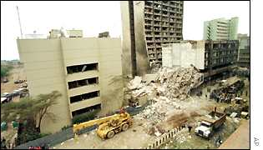

Slide 5
Introduction
As a transnational organised crime, international terrorism has long been recognized as a serious external and domestic security threat to many states of international community.
There is need for states to use all tools at their disposal, diplomacy, international cooperation, and constructive engagement, economic sanctions, covert action, physical security enhancement, and military force.
Terrorism is both highly concentrated as well as a globally distributed phenomenon (2016 GTI report)
The Report further indicates that terrorism is mostly committed in a small number of countries and by a small number of groups.

Slide 6
Accordingly, five countries suffering the highest impact from terrorism are; Iraq, Afghanistan, Nigeria, Pakistan and Syria, accounted for 72 per cent of all deaths from terrorism in 2015.
Comparatively, the vast majority of victims of terrorist attacks over the past 15 years has been Muslims killed by Muslims.
Similarly, only four groups were responsible for 74 per cent of all these deaths; ISIL, Boko Haram, the Taliban and al-Qaida.
Mechanism of attack vary greatly depending on intention, actors, time and location.
Nature of target varies depending on the value. The higher the value of target the more the attraction to be a target.
Effects of terrorism can either be positive or negative on the economy. These effects can be categorised under economic, social, political, psychological, and environmental among other categorisations.

Slide 7
Meaning
There is no single internationally accepted definition of what constitutes terrorism
The terrorism literature abounds with competing definitions and typologies.
“Deliberate acts of a physical and psychological nature perpetuated on a select group of victims. Its intent is to mold the thinking and behaviour not only of these targeted groups but more importantly, of larger sections of society that identify or share the views of the targeted group or who might easily be led to do so” Frederick Gareau

Slide 8
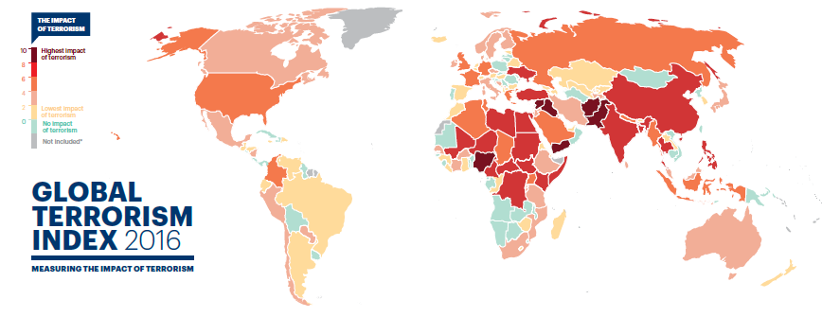

Slide 9
The GTI “the threatened or actual use of illegal force and violence by a non-state actor to attain a political, economic, religious, or social goal through fear, coercion, or intimidation.”
See other definitions by FBI, UK, EU, & Kenya.
These definitions recognise that terrorism is not only the physical act of an attack, but also the psychological impact it has on a society for many years after.
There is a multitude of situations capable of provoking terrorism.

Slide 10
New Trends in Terrorism
A modern trend in terrorism is toward loosely organized, self-financed, international networks of terrorists.
Tendency is for terrorism to be religiously or ideologically motivated.
Radical Islamic fundamentalist groups, or groups using religion as a pretext, pose terrorist threats of varying kinds to various state interests.
Apparent growth of cross-national links among different terrorist organizations, which may involve combinations of military training, funding, technology transfer, or political advice.
Increasing use of communication technology
Increasing use of networks
‘soft targets’ (lightly or undefended civilian targets and important symbols) are preferred.

Slide 11
Suicide bombing – has become fundamental characteristic of and strong attraction for the terrorist organizations because:
  Suicide bombings are inexpensive and effective.
  It is less complicated and compromising than other kinds of terrorist methods.
  Guarantees media coverage.
  The suicide terrorist is the ultimate smart bomb with no escape plan.
  The strategy of suicide terrorists is to make people paranoid and xenophobic, fearful of venturing beyond their homes.
Suicide attacks on average kill four times as many people as other terrorist acts.

Slide 12
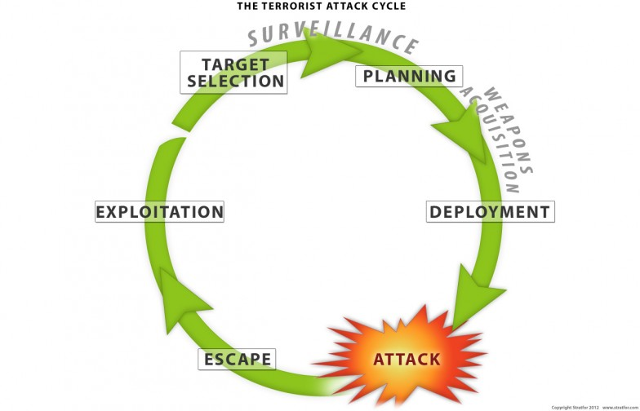

Slide 13
Common characteristics of terrorism
Violence
Psychological impact - Fear and panic among the population
Undermines public confidence in the ability of the authorities to protect and defend citizens, thereby creating a climate of fear and intimidation amenable to terrorist exploitation
Anonymous, unidentifiable threat creates huge anxiety
Usually the goals are political
Disguises are commonly used
Now, a growing percentage of terrorist attacks are designed to kill as many people as possible.
Most groups lack a concrete political goals other than to punish their enemies by killing as many of them as possible, without concern about alienating sympathizers.
Increasingly, attacks are less likely to be followed by claims of responsibility or lists of political demands.
Because groups based on ideological or religious motives may lack a specific political or nationalistic agenda, they have less hierarchical structure.

Slide 14
Terrorist organisation structures
Terrorist structure can generally be considered to be of four types:
Conventional hierarchy, provides the most efficient in terms of for example, intelligence, recruitment, finance and support. But it is least secure
Cellular- incorporates a network within a hierarchy. Each cell with about three to ten individuals, possesses one member (leader) who has direct contact with the organisation’s high command.
Network - comprises numerous cells interconnected in differing ways. Different types of such a network, each with different levels of security and efficiency. E.g.. Cain, Hub & Star
Leaderless resistance - is the opposite of the former and exhibits the highest security, least efficiency.
The decision to utilise any one of them depends on the security/efficiency trade-off of each.

Slide 15
Causes of Terrorism
People turn to terrorism for various reasons that include:
  Non-democracy and Political Grievances
  Ideological, (ideology aids selection of range of legitimate targets and the means by which terrorists try to justify attacks).
  Religious convictions.
  Some are simply criminals for hire.
  Others become terrorists because of perceived oppression or economic deprivation
  Ethnicity, nationalism/separatism. These are probably some of the most contested causes of terrorism.
  Globalisation
  The West’s application of double standards in its international behavior, e.g. perceptions of relations with Israel and the approach to the Middle-East Peace Process, Bosnia and Chechnya.

Slide 16
Types of conflict
Due to diversity od situations that provoke it, becomes difficult to generalize about terrorism, there are so many ‘terrorisms’.
State terrorism – terrorism from above committed by governments against perceived enemies. This can be directed externally against adversaries in the international domain or internally against domestic enemies
Dissident terrorism - is terrorism from below committed by nonstate actors (groups or movements) against governments, ethno national groups, religious groups and others perceived as enemies.

Slide 17
Religious terrorism - motivated by an absolute belief that an otherworldly power has sanctioned and commanded the application of terrorist violence for the greater glory of the faith.
International terrorism – one that spills over to the world’s stage. Targets are selected for their value as symbols of international interest, either within the home country or across state borders.
Cyber terrorism

Slide 18
Cyber terrorism – refers to planned, politically motivated attack against information, computer systems, computer programs, and data which result in violence against non-combatant targets by sub-national groups or clandestine agents.
It is the convergence of terrorism with cyberspace, where cyberspace becomes the means of conducting the terrorist act.
Rather than committing acts of violence against persons or physical property, the cyberterrorist commits acts of destruction and disruption against digital property.
Cyber terrorism is conducted by private entities and state governments.
Among the leading states are United States, South Korea, China, Germany, France, and The UK

Slide 19
Cyber terrorist prefer using the cyber-attack methods because of many advantages:
  It is Cheaper than traditional methods.
  The action is very difficult to be tracked.
  They can hide their personalities and location.
  There are no physical barriers or check points to cross.
  They can do it remotely from anywhere in the world.
  They can use this method to attack a big number of targets
  They can affect a large number of people.

Slide 20
State Terrorism
Terrorism by states is characterized by official support for policies of violence, repression, and intimidation.
This violence and coercion is directed against perceived enemies that the state has determined threaten its interests or security.
Although perpetrators of state terrorist campaigns are frequently government personnel, however, those who carry out the violence are also quite often unofficial agents of the government.
Is usually a covert, secret policy that allows states to claim deniability when accused of sponsoring terrorism.
Because of these veiled parameters, a distinction must be made between state patronage and state assistance models.

Slide 21
A number of models to describe state terrorism exist.
One Model describes state-level participants in a security environment as including the following:
1. Sponsors of terrorism, meaning those states that actively promote terrorism and have been formally designated as rogue states or state sponsors.
2. Enablers of terrorism, or those states that operate in an environment in which “being part of the problem means not just failing to cooperate fully in countering terrorism but also doing some things that help enable it to occur.”
3. Co-operators in counterterrorism efforts, including unique security environments in which “cooperation on counterterrorism is often feasible despite significant disagreements on other subjects.”

Slide 22
Domain | Patronage | Assistance
 | State participation in terrorist and extremist behaviour can involve either direct or indirect sponsorship and can be conducted in foreign or domestic policy domains. State patronage refers to relatively direct links between a regime and political violence. | State assistance for terrorism refers to relatively indirect links. The state, through sympathetic proxies and agents, implicitly takes part in repression, violence, and terrorism. State assisters are less explicit in sponsorship. State assistance includes policies that help proxies arm, train, and provide sanctuary for terrorists. The ambiguity with the proxy is intended to provide deniability when accused of complicity.
International | International violence conducted on government orders. Case: Assassination of former Iranian Prime Minister Shahpour Bakhtiar in France by Iranian operatives | International violence with government encouragement and support
Domestic | Domestic repression by government personnel Case: Argentina’s Dirty War conducted by the military (1976 and 1983) | Domestic repression by pro-government extremists Case: Violence by rightist paramilitaries in El Salvador’s 1980s civil war

Slide 23
Policy Response
Dilemmas
In their desire to combat terrorism in a modern political context, democratic countries often face conflicting goals and courses of action:
(1) Providing security from terrorist acts - This may include, limiting the freedom of individual terrorists, terrorist groups, and support networks to operate unimpeded in a relatively unregulated environment, versus
(2) maximizing individual freedoms, democracy, and human rights.
Efforts to combat terrorism are complicated by a global trend towards deregulation, open borders, and expanded commerce.

Slide 24
Another challenge for policymakers is the need to identify the perpetrators of particular terrorist acts and those who train, fund, or otherwise support or sponsor them.
As the international community increasingly demonstrates its ability to unite and apply sanctions against rogue states, states will become less likely to overtly support terrorist groups or engage in state sponsored terrorism.
The possibility of covert provision of weapons, financing, and logistical support remains, and detecting such transfers will require significantly increased deployment of intelligence assets in countries and zones where terrorists operate.

Slide 25
Facing the possibility that a number of states may be rethinking their sponsorship of terrorist organizations, such organizations appear to be establishing operating bases in countries that lack functioning central governments or that do not exercise effective control over their national territory.
Terrorists have been able to develop their own sources of financing, which range from NGOs and charities to illegal enterprises such as narcotics, piracy, extortion, and kidnaping.
Al Qaeda depends on a formidable fundraising operations including Muslim charities and wealthy well-wishers, legitimate-seeming businesses, and various smuggling and fraud activities.

Slide 26
Policy Tools to Combat International Terrorism
1. Diplomacy/Constructive Engagement
Use of diplomacy to help create a global anti-terror coalition is a central component of response to terrorist events.
Diplomacy, for example, was a key factor leading to the composition of the U.S.- led coalition against the Taliban.
Diplomacy may not always be effective against determined terrorists or the countries that support them.
However, in most cases, diplomatic measures are considered least likely to widen conflicts and therefore are usually tried first.

Slide 27
When responding to incidents of terrorism by subnational groups, reacting by constructive engagement is complicated by the lack of existing channels and mutually accepted rules of conduct between governmental entities and the groups in question.
In some instances, legislation may specifically prohibit official contact with a terrorist organization or its members.
Yet for groups that are well-entrenched in a nation’s political fabric and culture, engaging the group might be preferable to trying to exterminate it.

Slide 28
2. Use of media
The media remain powerful forces in confrontations between terrorists and governments.
Influencing public opinion may impact not only the actions of governments but also those of groups engaged in terrorist acts.
From the terrorist perspective, media coverage is an important measure of the success of a terrorist act.
Public diplomacy and the media may help mobilize public opinion in other countries to pressure governments to take action against terrorism.

Slide 29
3. Economic Sanctions
Sanctions regimes can be essentially unilateral — such as U.S. bans on trade and investment relations with Syria and Iran — or multilateral, such as that mandated in response to the Pan Am 103 bombing on Libya.
Sanctions also can be used to target assets of terrorist groups themselves.
The effects of these economic measures are uncertain because much of the flow of terrorist funds reportedly takes place outside of formal banking channels (in elusive “hawala” chains of money brokers).
Furthermore, much of Al Qaeda’s money is believed to be held not in banks but in untraceable assets such as gold and diamonds.

Slide 30
Nation-states’ economic sanctions fall into six categories:
restrictions on trading,
technology transfer,
foreign assistance,
export credits and guarantees,
foreign exchange and capital transactions, and
economic access.
total or partial trade embargo,
restrictions on aircraft or ship traffic,

Slide 31
4. Economic stimulus
Counter-terrorism initiatives might include efforts to change economic and social conditions that provide a breeding ground for terrorists.
Some have suggested that most terrorists worldwide are unemployed or underemployed with virtually non-existent prospects for economic advancement.
Some analysts believe that targeted assistance programs to reduce poverty and increase education (which might also include supporting secular educational alternatives to the Madrassahs — Islamic religious schools) can make a difference in lifestyles and attitudes and diminish the appeal of extremist groups.

Slide 32
Critics, though, argue that severe economic conditions are not the sole or even the main motivational factors driving the emergence of terrorism, stressing that resentment against a particular country or political order and religious fanaticism also are important motivations.
Osama bin Laden’s large personal fortune and his far-flung business empire would seem to contradict economic deprivation as explanations of his terrorism.

Slide 33
5. Covert Action
Intelligence gathering, infiltration of terrorist groups, and military operations that involve a variety of clandestine or “covert” activities are critical in counter-terrorism campaign.
Much of activity should involve passive monitoring nature aimed at determining the strategic intentions, capabilities, and vulnerabilities of terrorist organizations.
Covert action may also seek to exploit vulnerabilities of terrorist organizations, for example, by spreading disinformation about leaders, encouraging defections, promoting divisions between factions, or exploiting conflicts between organizations.

Slide 34
Some nations have periodically resorted to unconventional methods beyond their territory for purpose of neutralizing individual terrorists and/or thwarting pre-planned attacks.
Examples of activities might range from intercepting or sabotaging delivery of funding or weapons to a terrorist group, to seizing and transporting a wanted terrorist to stand trial for assassination or murder.
Arguably, such activity might be justified as pre-emptive self-defence under Article 51 of the U.N. charter.
On the other hand, it could be argued that such actions violate customary international law.

Slide 35
6. Extradition/Law Enforcement Cooperation
International cooperation in such areas as law enforcement, customs control, and intelligence activities is an essential pillar of the any government anti-terrorism policy.
For example, the stationing of FBI agents overseas in close to 50 countries facilitates investigations of terrorist crimes and augments the flow of intelligence about terrorist group structures and membership.
One law enforcement tool in combating international terrorism is extradition of terrorist suspects.
International extradition traditionally has been subject to several limitations, including the refusal of some countries to extradite for political or extraterritorial offenses or to extradite their nationals.

Slide 36
7. Military Force
Although with difficulties, military force, particularly when wielded by a superpower such as the United States, can carry substantial clout.
Proponents of selective use of military force usually emphasize the military’s unique skills and specialized equipment. The April 1986 US decision to bomb Libya for its alleged role in the bombing of a German discotheque exemplifies use of military force against terrorism.
Successful use of military force for pre-emptive or retaliatory strikes presupposes the ability to identify a terrorist perpetrator or its state sponsor, as well as the precise location of the group, information that is often unavailable from intelligence sources.
Generally, terrorists possess modest physical facilities that present few high-value targets for military strikes.

Slide 37
Some critics have observed that military action is a blunt instrument that can cause foreign civilian casualties as well as collateral damage to economic installations in the target country.
Others argue that such action inflates terrorists’ sense of importance and facilitates their recruitment efforts.
Other disadvantages or risks associated with the use of military force include counter-retaliation and escalation by terrorist groups or their state sponsors,
Failure to destroy the leaders of the organization, and
The perception that rules of international law are violated .

Slide 38
8. International Conventions
The world community is developing major anti-terrorism conventions. These conventions impose on their signatories an obligation either to prosecute offenders or extradite them, or permit prosecution for a host of terrorism-related crimes, including hijacking vessels and aircraft, taking hostages, and harming diplomats.
Important conventions include:
the Convention for the Marking of Plastic Explosives.
the U.N. Convention on the Suppression of Terrorist Bombings, and
the U.N. Anti- Terrorism Financing Convention .

Slide 39
Other instruments of Countering Terrorism
Many states base counterterrorism policy on three pillars; - Make no concessions to terrorists / strike no deals, bring terrorists to justice for their crimes.
Proscription of terrorist organisations and enactment of relevant laws
Identification and confiscation of terrorist property and accounts.
Granting security forces special powers to cordon areas; stop and search of persons and premises; arrest without warrant and to facilitate investigations
Enforcement of border controls
Preventing terrorism by tackling the radicalization of individuals

Slide 40
Tackling disadvantage and supporting reform - addressing structural problems in the developing world that may contribute to radicalization, such as inequalities and discrimination
Engaging in the battle of ideas - challenging the ideologies that extremists believe justify the use of violence
Protecting key national services and utilities
Preparing for the consequences - Identifying the potential risks the country faces from terrorism and assessing their impact + frequent exercises to improve response to incidents + learning lessons from incidents that have taken place

Slide 41
For Counter- Cyber terrorism
a. Passive defence is essentially target hardening. It largely consists of the use of various technologies and products and procedures to protect the information technology assets.
Prevention: A basic approach is to design the system to be secure from an attack from the beginning. Another general way to try to prevent attacks is to take measures to ban them.
Incident management, mitigating an attack, damage limitation. Provide indications and warnings that an attack is taking place. To prevent penetration of the system at risk from the outside, erect barriers and otherwise harden it.
Consequence management through recovery and response. Recovery is about reconstituting IT assets so that the organization can operate as close to normal as possible as soon as possible.

Slide 42
DISCUSSION
Identify the key challenges in the fight against international terrorism.

Slide 43
